Slide 1
IPv6: are we there yet?
Stephen White and David North
January 2019
CompSoc sysadmins of the early 21st century, David North and Stephen White, will talk about IPv6: now that we've "run out" of IPv4 addresses, how is adoption of the new version going? Are businesses, academia and residential users queueing up to embrace the future? Or were the predictions of problems wildly over-hyped and we're all getting along fine as we are?

Slide 2
About the company
Notes:
We are a software company with our UK offices in Oxford
Founded in 1997
We currently have just over 60 staff
We make software for banks, insurance companies and government agencies – e.g. HMRC and the Bank of England
Lots of interesting technology involved

Slide 3
Stephen introduces himself
1998-2001
stephen.white@keble.ox.ac.uk (kebl1088)
swhite@ox.compsoc.net
2001-present
swhite@corefiling.com
Also some contracting and other stuff
Some early E Commerce, We7, personal domain

Slide 4
David introduces himself
2006-2009
david.north@magd.ox.ac.uk
north@ox.compsoc.net
2009-present
dtn@corefiling.com
2007-present
david@dnorth.net (everyone should have their own domain name)
Notes:
My life in e-mail addresses. I studied Computer Science here a decade ago, and have worked for CoreFiling since them – starting as a developer, then a team leader, and most recently as Head of Engineering, running the entire development department.
As mentioned, I was in CompSoc back in the day as treasurer and systems administrator, and I’ve done a few side projects since – most recently an invoicing system for my church hall.

Slide 5
Quick introduction to IPv6
facebook.com -> 157.240.1.35
10011101 11110000 00000001 01000011
157 240 1 35
Notes:
[David]
As I’m guessing most of you know, computers which are networked together, both on the internet and within an office or home, generally use the Internet Protocol (IP). This identifies each computer by assigning it an IP address, which is usually written as four decimal numbers with dots between them.
Under the hood, an IP address is designed to be kept as a binary number which is 32 bits long, which is why each of those groups of digits can only be from 0 to 255.

Slide 6
Address exhaustion
2³² possible addresses
Private = 192.168.x.x, 172.(16-32).x.x, 10.x.x.x
Notes:
So, naively there are two to the power of 32 possible addresses, which is about four billion. That seemed like plenty when the internet was first dreamt up, but the population of earth is over seven billion, and it’s not hard to imagine a future where the average number of connected devices per person will rise above two.
The good news is that there are various blocks of IP addresses reserved for “private” usage on people’s internal networks, and these combined with something called Network Address Translation or NAT, allow most homes and small offices to use just one IP address on the internet and use private addresses internally which can be duplicated between networks.

Slide 7
Notes:
The bad news is that we were quite wasteful with allocation of addresses to organisations in the early days. And the even worse news is that because of various technical limitations, you can’t assign addresses to ISPs in blocks of less than 1,024, which can result in wasted space.

Slide 8
Notes:
So, the executive summary is that we’re running out of IP addresses
This graph shows the number of /8 blocks remaining for each of the different regional registries, and as you can see, in Europe we’re pretty much out and have been for some years.

Slide 9
facebook.com -> 2a03:2880:f129:83:face:b00c:0:25de
Notes:
So, the plan is to upgrade to IPv6, where addresses are 128 bits long, giving us vastly more to play with and meaning they are written out differently – we use hexadecimal in our groups of four, and we use double colons to collapse down long runs of zeros.
However, IPv6 is a whole new thing which is not backwards compatible with IPv4. So potentially you need to run both alongside each other for a while, because some of the things you are trying to connect to will only be available on one or the other.

Slide 10
End users: Broadband
Notes:
[David]
So, let’s take a look at whether IPv6 is being used on end user networks. We’ll start with home users and their broadband connections.
There are various websites you can visit to test whether you have a working IPv6 connection, and this is the result of me visiting one at home using a laptop running Windows 10, and a BT Infinity internet connection with the router supplied by BT. As you can see, it all works – and I didn’t have to configure or change anything; the connection has been like this since I got it a couple of years ago.
Sky were the first major UK ISP to roll out IPv6 by default, largely because they do not have enough IPv4 addresses to give one each to their end users any more. BT are somewhat better off but given their size and aggressive expansion recently, it’s no surprise they were next.
Based on 2018 figures, Sky and BT between them have 50% of the UK home market, so that means one in two households will have IPv6, probably without being aware of it.

Slide 11
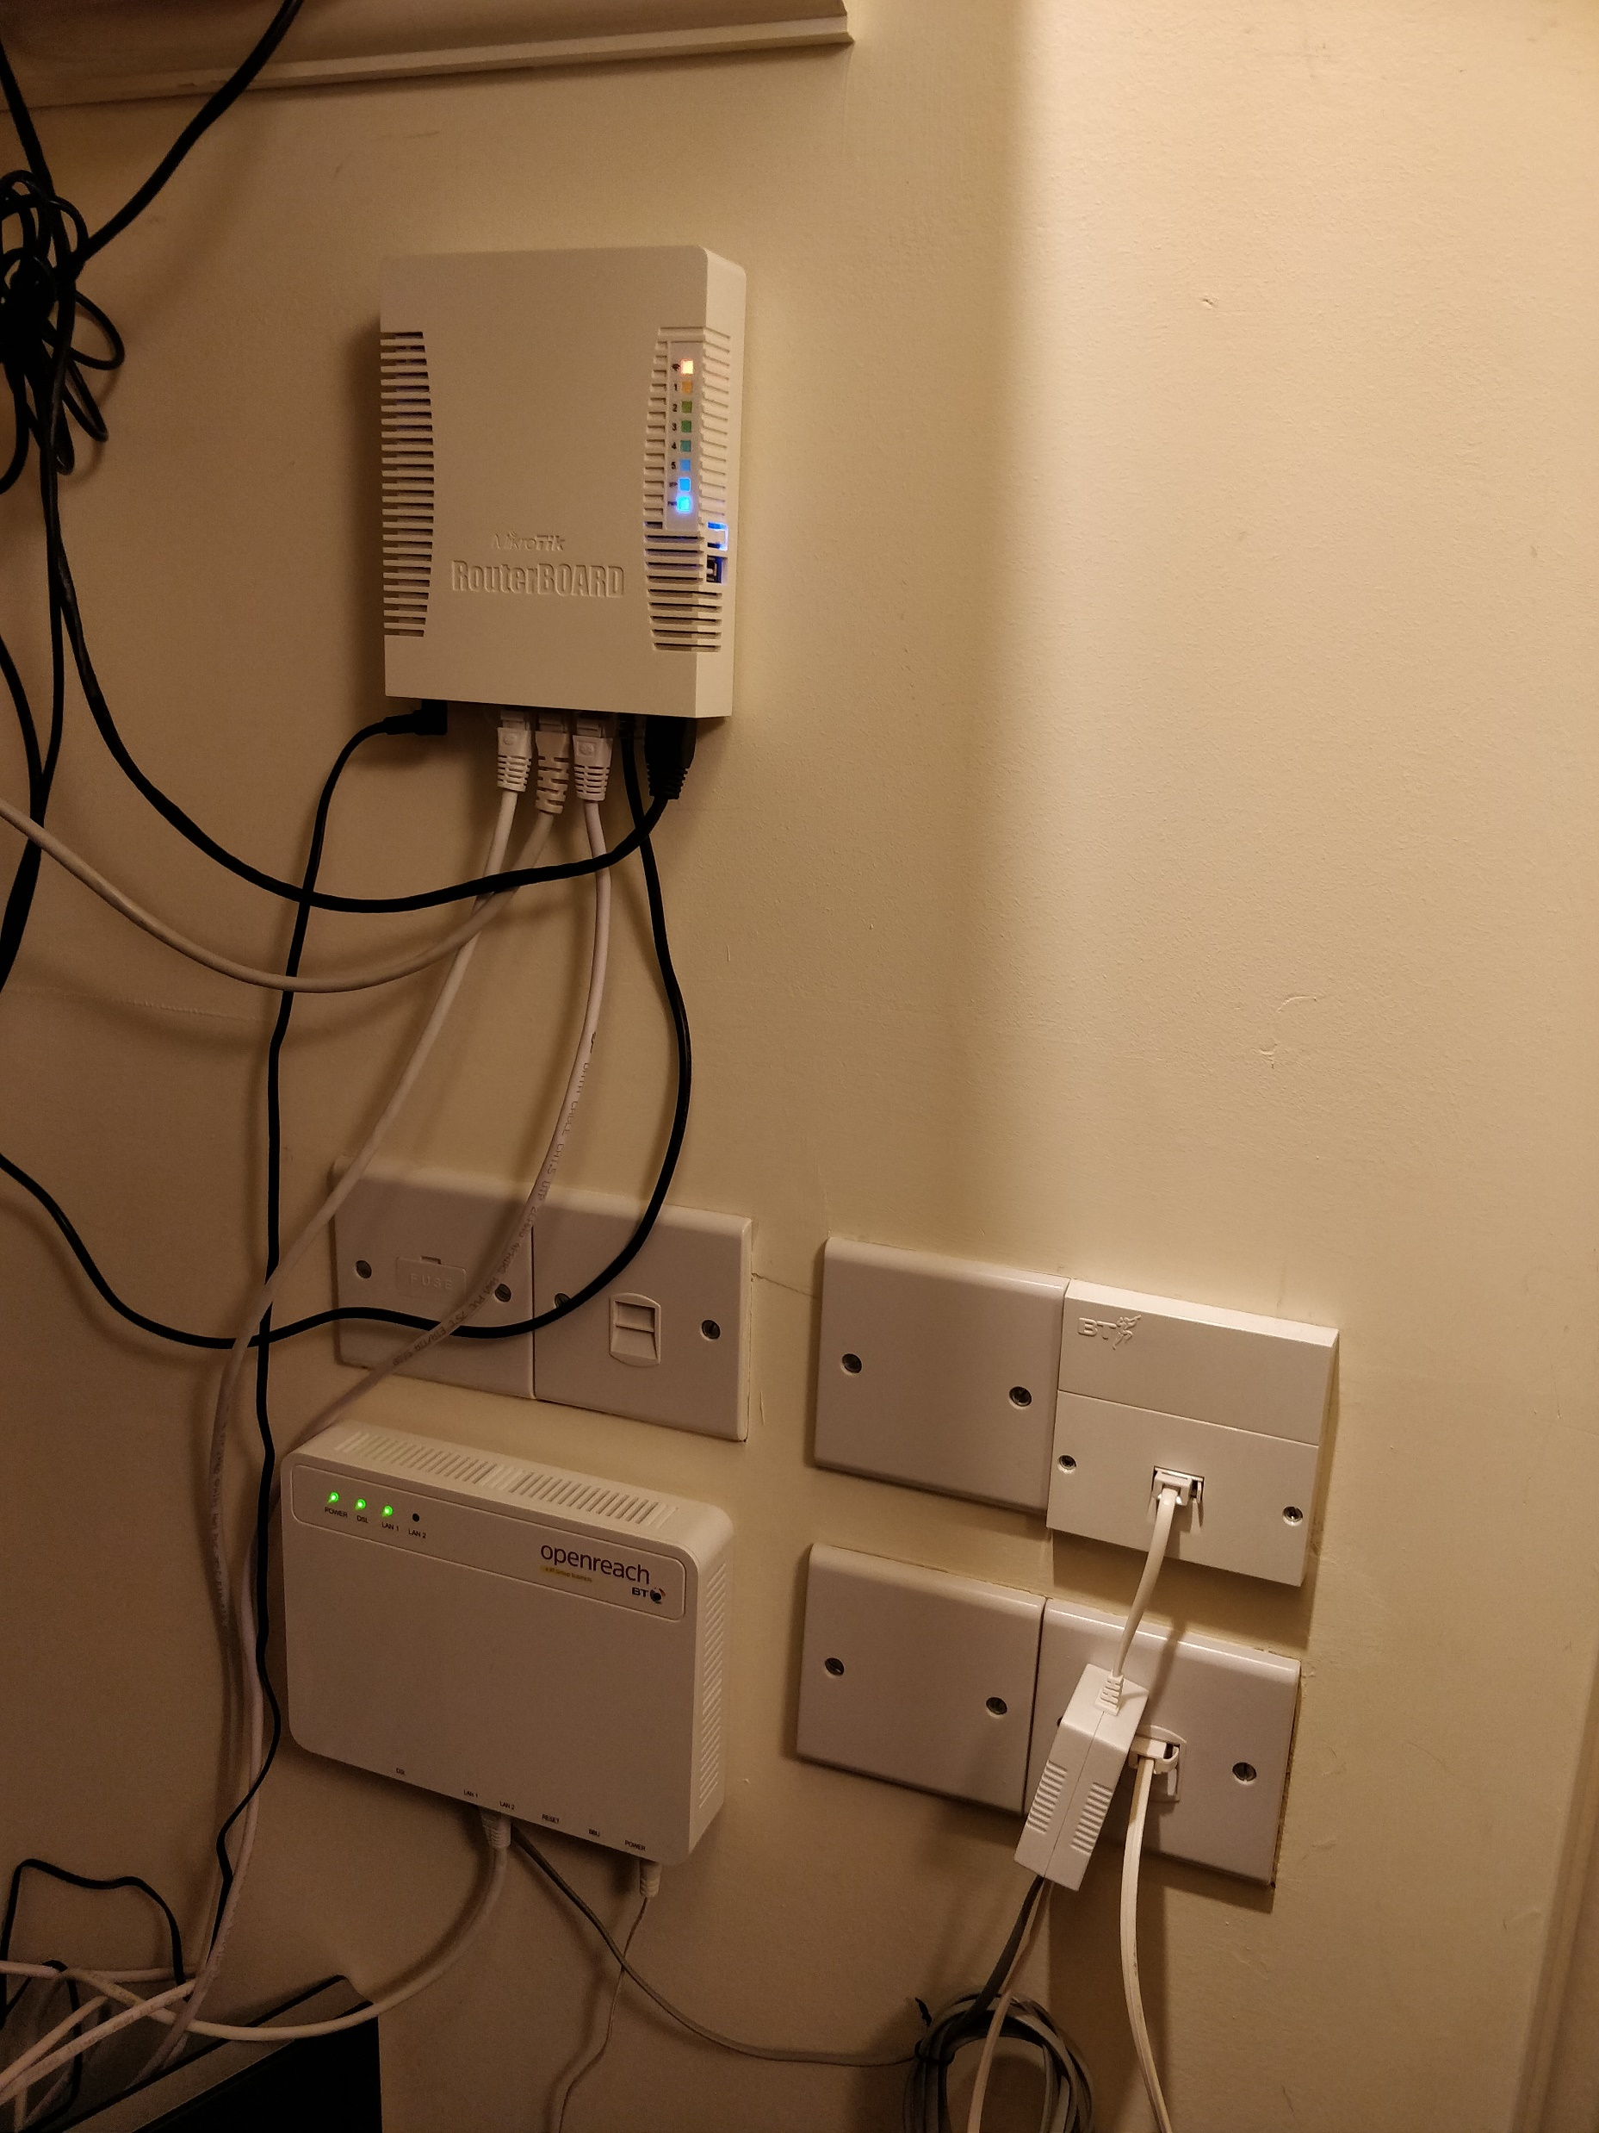
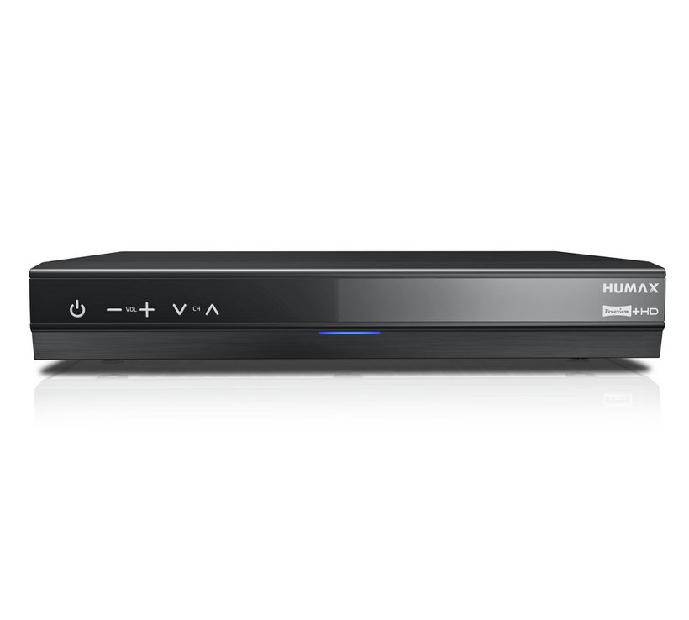
Hardware and software support
Notes:
Obviously, you need a router that supports it. If you’re a typical BT or Sky user, then they ship you a magic box, you plug it in, and everything works. If you’re a less typical user, like me, you run your own router. Some manufacturers still don’t properly support IPv6, or label it as alpha. Microtik are one of the ones who get it right, and you can see one of theirs mounted in my cupboard here.
Most phones, PCs and tablets will support it – every major operating system has had this sorted going back 15 years or more. On the other hand, there will be connected devices in every home which don’t support it, and you can see a couple of mine on the right – the hub for my smart heating, and my DVR, both lack IPv6 support.

Slide 12
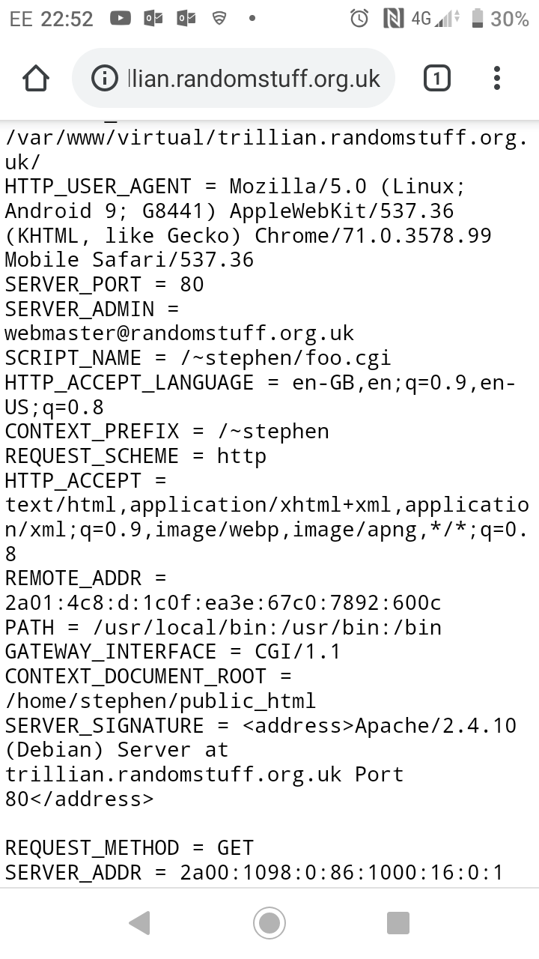
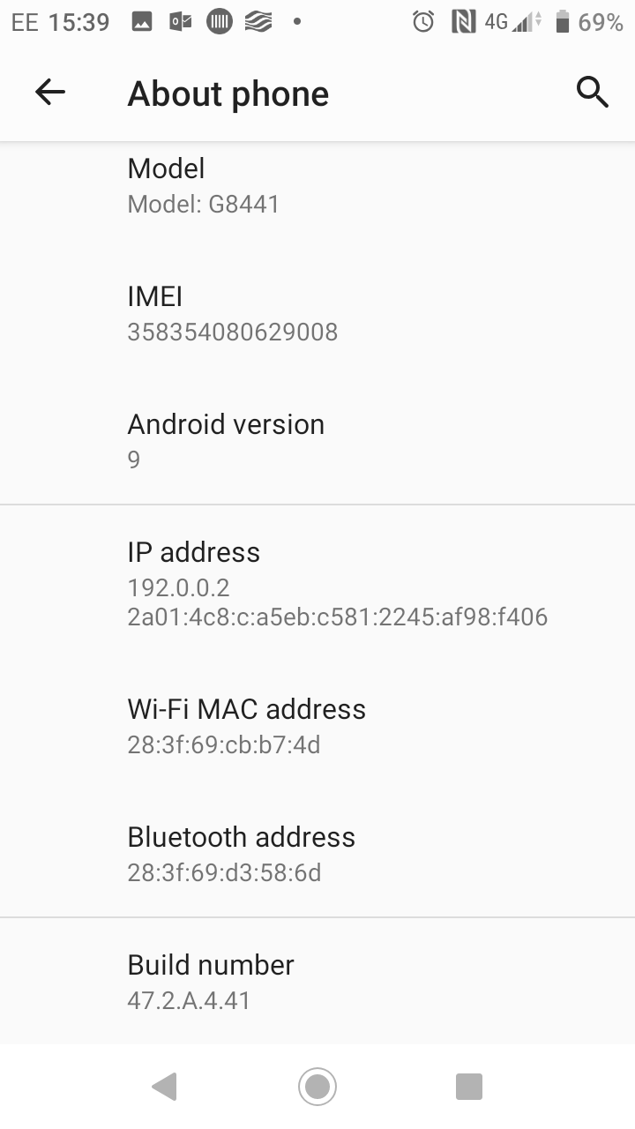
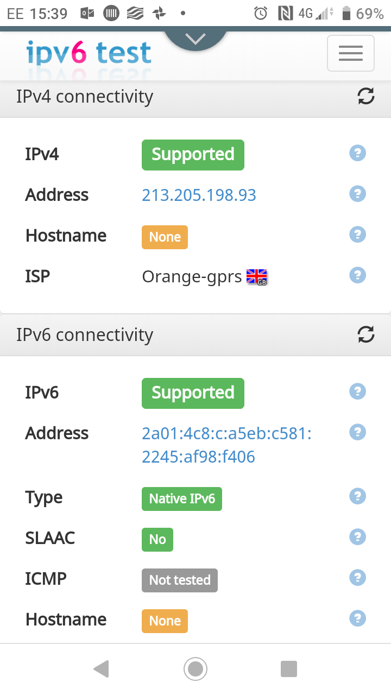
End users: mobile
Many mobile networks are IPv6
E.g. EE
Carrier-grade NAT from 192.0.0.2 (DS-LITE) to give access to IPv4 only servers.
Beware, I do sometimes seem to end up on IPv4 only which doesn't have a public IP at all, always NAT from 10.*, e.g. 10.206.196.54
Either way, my mobile device isn't consuming a public IPv4 address
Notes:
swhite

Slide 13
End users: businesses
Implementing anything new takes time
Purchasing, set-up and training all take time
Time is money
It isn't just the equipment cost
Business will want to see a return on investment in this project
Is the status-quo causing a problem?
Can I get the IPv4 addresses I need (not many unless I'm running an ISP)?
Are clients demanding it?
Is there a piece of software or service that won't work without it?
Right now, the answer to all of the above is normally "No".
Notes:
swhite

Slide 14
End users: businesses
What about big business?
Migration is a bigger deal, but surely they want to be ready?
Microsoft?
They are now dual stack IPv4 and IPv6
They had a business motivation to go IPv6 only. They're so big that following some expansions they're even short on RFC1918 space for internal networks:
https://blog.apnic.net/2017/01/19/ipv6-only-at-microsoft/
Delay #1:
As that blog post notes they were slowed down by "a DHCPv6 bug in Windows 10".
Try moving just their guest network instead?
Delay #2:
Apparently that caused problems because they found people couldn't connect to IPSec VPNs
Aside: use OpenVPN. We do, and we've found the experience much better than IPSec
https://blog.apnic.net/2018/09/17/microsoft-making-progress-towards-ipv6-only/

Slide 15
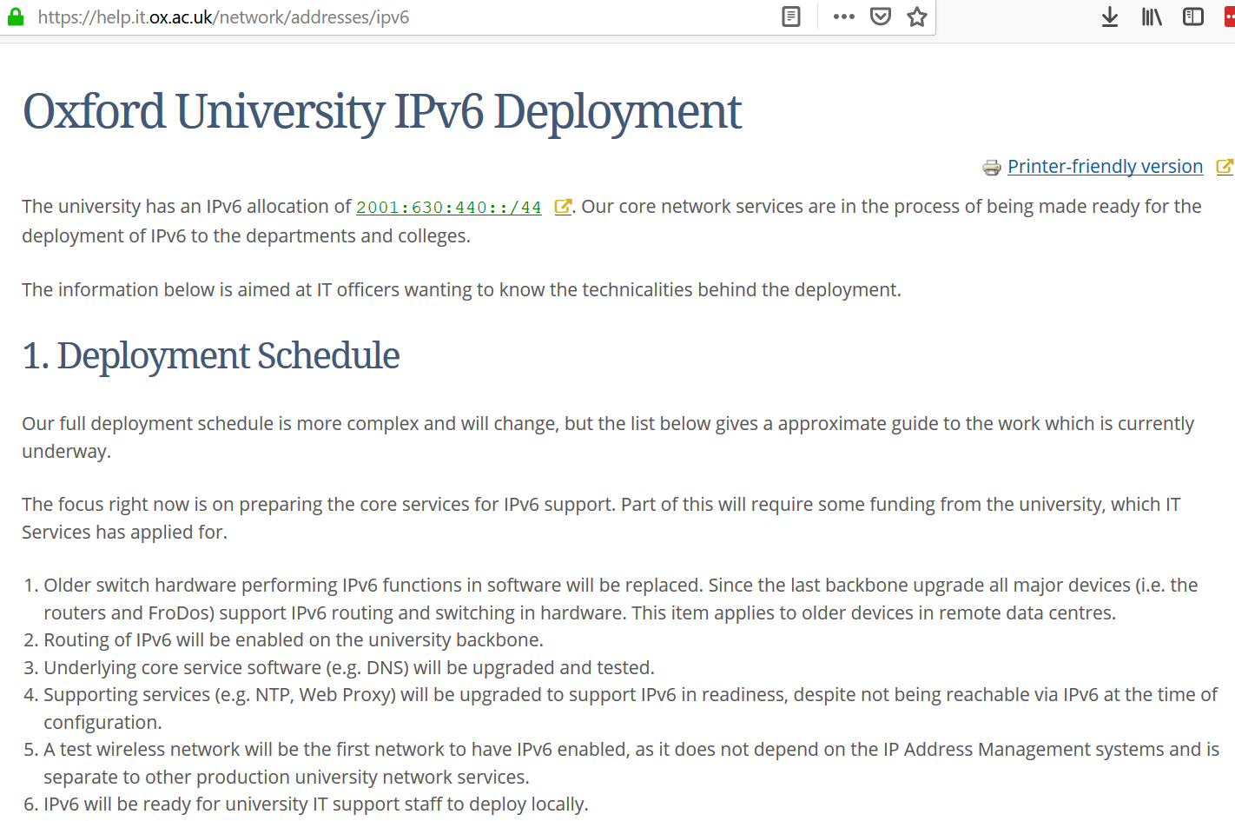
End users: academia
Notes:
[David]
If you Google for “Oxford University IPv6”, you find this page, which looks suspiciously similar to how I remember it in 2009. Having said that, it looks like the hardware upgrades – firewalls and routers – have now taken place, and the addresses have been allocated. However, the page doesn’t say there will be any end users or services enabled any time soon, and I suspect there is not yet enough pressure to justify funding further work.
There are some different stories – last year, MIT were able to fund their IPv6 roll out by selling off unused IPv4 space – but they had vastly more than Oxford to begin with.

Slide 16
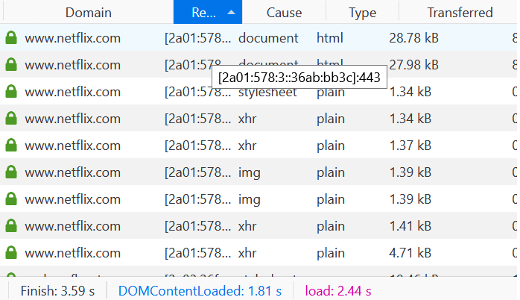
Content providers
Notes:
As you can see from my developer tools here, Netflix led the way on supporting IPv6 (they’re mostly hosted in Amazon Web Services). They account for around 15% of global bandwidth demand, but even though I have IPv6 on my home network, the device I usually watch Netflix on is my television, which is IPv4 only.
Facebook is all IPv6. Google have now rolled it out virtually everywhere.
Large UK sites like the BBC are still IPv4 only.

Slide 17
Apple
Notes:
Apple are thinking ahead, and requiring everything on the app store to work if only IPv6 is available. No sign of similar moves from Google just yet.

Slide 18
Hosting companies
AWS:
Amazon were a bit slow but IPv6 has been properly supported by AWS for 18 months to 2 years (US East came first)
https://aws.amazon.com/blogs/aws/new-ipv6-support-for-ec2-instances-in-virtual-private-clouds/
Mythic Beasts:
Have supported IPv6 natively for many years
Charge £20/year extra for virtual servers with IPv4, and don't offer native IPv4 on their Raspberry Pi hosting
Notes:
Swhite
Amazon charge for static IPv4 addresses ("Elastic IPs") attached to stopped instances
IPv6 addresses for instances are all static, and don't get charged for while the instance is stopped

Slide 19
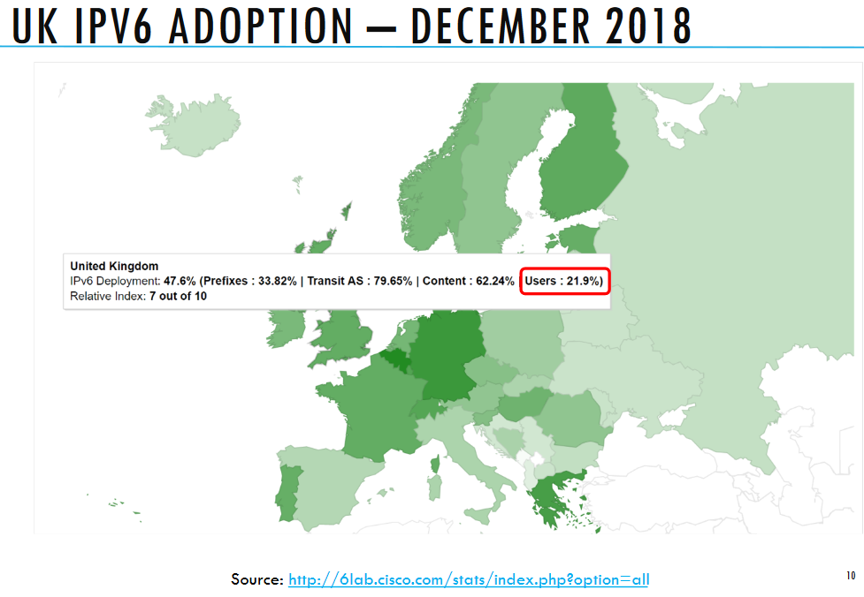
Where we are
Some stats?
Notes:
[David] So, you can see how we’re doing – not too bad on a global scale, still some work to do but at least a meaningful percentage. If there’s one thing which will continue to drive it, that’s the economics. Now that IPv4 addresses are a scarce resource, they change hands for a meaningful amount of money – Microsoft and Amazon, and other large cloud operators, have been buying up bankrupt companies with lots of IP addresses and otherwise taking them on the secondary market. But that won’t last for ever.

Slide 20
The future
Many people don’t need as many IP addresses as in the past
HTTPS once required unique IP addresses
SNI
Easier availability of wildcard certificates (Letsencrypt!)
Access internal corporate services via a VPN rather than public IPs
Better for security as well
Mobile networks – biggest growth area
Most IPv6 already or doing carrier grade NAT
IPv6 is gaining ground and will happen, but adoption is going to continue to progress slowly
Much adoption will be dual-stack for several years to come
Notes:
swhite

Slide 21
The future continues…
Increased residential roll-out likely to continue
Government trying to force it via procurement/bids in some cases we've seen
Commercial users likely to be several years from widespread adoption: business cases still lacking for all but the biggest
Still a bit of a chicken and egg situation: not compelling until some content only accessible via IPv6, but nobody has done this for obvious reasons
Notes:
swhite

Slide 22
Questions?
Don’t forget we’re looking for summer interns!
corefiling.com/interns2019

